Slide 2
Refereeing the Robot Game

Slide 3
Tournament Goal
The team members should have fun showcasing their unique ideas and hard work
Referees do this mostly through expert application of the rules
Celebrate and spread the word

Slide 4
What happens in a match?
Equipment inspection with team and referee
Team prepares robot for first launch
Wait for signal to start, then team runs their match
At end of match, no one touches anything (except to halt the robot) and fill out scoresheet
Scoring program is used to calculate the match score
Notes:
Presenter(s):
Moderator(s):

Slide 5
Table Referee Role
Learn and Practice!
Reset and inspect the Field
Put the children at ease
Govern the Action
Make Judgment Calls
Record Performance

Slide 6
Learn and Practice
If the tournament schedule permits, referees should try to visit the pit area and watch teams at the practice tables
Team members will have questions, and you can see any unusual strategies that you might want to alert the rest of the refs about
Focus on: Updates, Rules, Missions

Slide 7
Reset and Inspect the Field
You may have a Table Setter/Referee Assistant to help you reset the field between matches, but the ref is responsible for the condition of the field
If there are any errors or possible errors seen during the match, the team gets the Benefit of the Doubt, and any points associated
Focus on Field Setup and Missions

Slide 8
Put the children at ease
  They will be nervous, especially in the first round
  Calm and reassure
    “What does your robot do first?” “What’s really cool?”
    “Does your robot have a name?” “Favorite mission?”
  Joke, wear funny hats
  Get down to their level

Slide 9
Govern the Action
Allow or Not Allow action
  There is no unfairness or cheating
  There is only allowable (let it happen) and not allowable (try to correct it)
  No penalties—except as described in the rules (R16, R19/Missions) + consequences (R12, R21, etc.)
  No do-overs for allowable action (R12, R21)
  Remind the team if something isn’t allowable
  Two team members at the table at one time (R08)
    Others may swap in at any time.
    Exception: major emergency repair

Slide 10
Govern the Action
Launches and Re-Launches (R13, R14)
  Robot and everything (in control of the team) that it is about to move is completely within Launch Area
  Home (including Launch Area) has no height limit
  Nothing is being kept from moving
  Activate Robot by hand or passively by timer
Match start—beginning of the last word/sound in the countdown (“3-2-1-Lego!)

Slide 11
Govern the Action
Determine where objects are kept after they are moved
  Active robot makes changes – leave them alone
  Robot & Cargo interrupted = touched/interacted with (R16, R18)
  “Completely In Home” – Robot and Cargo are assessed independently of each other
  Mislaunch exception – if still inside the launch area arc, no loss of precision token, just relaunch
 | Robot | Model/Equipment
Completely in Home | OK - no precision token lost | OK - keep it
Not Completely in Home | Take a precision token | Robot had it at Launch | Ok - keep it
 |  | Robot picked it up during run | Take out of play

Slide 12
Govern the Action
Determine where objects are kept after they are moved
  Stranding (R19) – Robot loses contact with cargo (Mission Model – or – Equipment)
  “In home” – Each cargo item is assessed independently when it comes to rest
  This may have a significant effect on beginning teams that grab and re-aim a lot
 | Model/Equipment
Completely in home | OK - keep it
Partly in home | Keep it and take Precision token
Completely out of home | Leave where it is

Slide 13
Govern the Action
Pieces of a broken Robot– recover, no penalty (R12)
  Robot includes Equipment attached by hand, designed not to separate (R03)
Can’t interfere with opposing team or field, unless allowed in a Mission (R20)
  Opponent gets points if missions fail due to interference
Can’t score by breaking the field (R20)
Models must separate immediately when pulled away from Robot or other object (R04)

Slide 14
Govern the Action
Teams may store equipment or mission models in Home
  May not store on Field outside of Home
  May not store off the Field
  May not be held by other team members, only by technicians

Slide 15
Govern the Action
Make Judgment Calls
  Take the wording at face value (R23)
    If a detail is not mentioned, then it does not matter
  Give Benefit of the Doubt (R25)
  Talk it over with the Head Referee (R26)
Focus on Updates, Rules, Missions
Be correct, exact, and consistent, but see the big picture
Fairness is Job #1, but not Goal #1

Slide 16
RePLAY Robot Game
Missions
Notes:
Presenter(s):
Moderator(s):

Slide 17
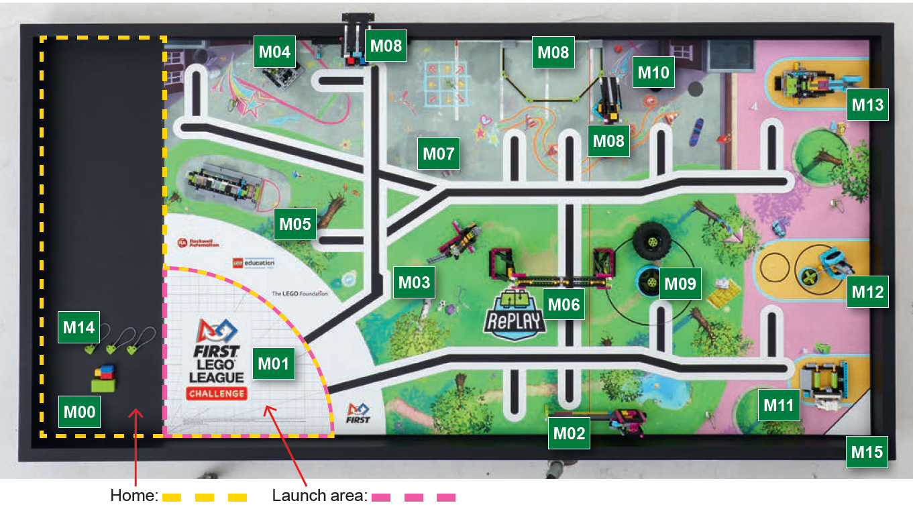

Slide 18
M00: Equipment Inspection Bonus
SCORING CONDITION:
  Before the match begins, the team shows the referee that all team equipment fits inside either the Small Inspection Space or the Large Inspection Space
SETUP:
  The entire field is set up for the match.
  Recommendation: Put all Mission Models that start in Home in the Large Inspection Space
DETAILS:
  Each Inspection Space has a ceiling 12.0 in. (305 mm) high
  If all team equipment cannot fit inside the Large Inspection Space, the team must remove enough to fit
    Removed equipment is not available for use during the match
  After the Equipment Inspection, the team may spread things out in Home as desired

Slide 19
M01: Innovation Project
SCORING CONDITION:
  The Innovation Project is touching either the RePLAY logo or the gray area around the bench
SETUP:
  The team brings its Innovation Project model to the table
  The Innovation Project is
    A single model
    Made of at least two white LEGO pieces
    Measures at least four LEGO studs long in some direction
DETAILS:
  The Innovation Project must touch the mat to earn points
  The Innovation Project is part of team equipment

Slide 20
M02: Step Counter
SCORING CONDITION:
  The bottom of the Step Counter pointer is over Magenta, Yellow, or Blue
SETUP:
  Green panel is all the way west
DETAILS:
  If the pointer is over two different colors, give credit for the color with the higher score

Slide 21
M04: Bench
SCORING CONDITIONS:
  The bench seat is down flat on the mat
  The bench seat is down, and cubes are touching the mat in the hopscotch spaces
  The bench backrest is completely out of both its holes
SETUP:
  The bench seat is raised, and the bench backrest is inserted in the seat
DETAILS:
  The cubes must be touching the mat somewhere in the hopscotch spaces to earn points. The cubes do not have to be flat on the mat.

Slide 22
M05: Basketball
SCORING CONDITIONS:
  A cube is in the crate
  The crate is raised so that it rests on the white stopper for either the middle or top height
SETUP:
  The crate is all the way down the pole
  The crate is empty
DETAILS:
  There are no extra points for more than one cube in the crate
  The robot can slide the crate all the way off the pole. There is nothing to stop it at the top of the pole

Slide 23
M06: Pull-Up Bar
SCORING CONDITIONS:
  At any time during the match the robot passes completely through the pull-up bar frame
  At the end of the match, the pull-up bar holds 100% of the robot off the mat
SETUP:
  No special setup
DETAILS:
  When the match timer expires, check to see whether the robot is 100% off the mat. If it sinks or falls any time after that, the robot will still score the “held up” points
  The team can only score end-of-match points for M06 or M07, not both

Slide 24
M07: Robot Dance
SCORING CONDITIONS
  At the end of the match, Robot’s controller is at least partly over the dance floor (blue chalk lines) and is in a “dancing” motion
SETUP
  No special setup
DETAILS
  Any repetitive action counts as dancing. May be with wheels or other movable attachments
  When the match timer expires, check to see whether the robot is at least partly over the dance floor. If the robot moves off after that, it still scores
  The team can only score end-of-match points for M06 or M07, not both
  Use Benefit of the Doubt if you are not certain that the robot was not over the floor

Slide 25
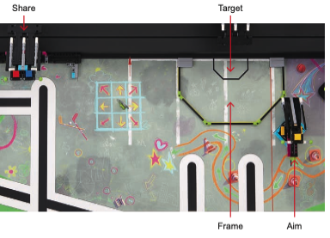
M08: Boccia
SCORING CONDITIONS
  Both share models sent only one cube to the opposing field, and the two cubes are the same color
  Cubes completely in either the frame or target
  At least one yellow cube completely in target
  No equipment in the frame
SETUP
  Share model has red and blue cubes on matching areas
  Aim model has yellow cube and is aligned with the mark
  Cubes in home: 1 yellow, 2 red, 2 blue, 8 green
DETAILS
  Remote matches: team scores points for the share model if they can send one cube over north wall
  Team may not interact with opposing field share model—M08 does not provide an exception

Slide 26
M09: Tire Flip
SCORING CONDITIONS
  The light tire (blue tread) has its white center up
  The heavy tire (black tread) has its white center up
  Scoring tires are completely in the large target circle
  Each tire must rest only on the mat to score.
SETUP
  Tires placed within outline marks, green center up
DETAILS
  Heavy tire does not score if it crosses the red flip line at any time

Slide 27
M10: Cell Phone
SCORING CONDITIONS:
  Cell phone is white side up
  Cell phone is resting only on the mat
SETUP:
  Black side up
  Within outline mark

Slide 28
M11: Treadmill
SCORING CONDITIONS:
  Robot spins the rollers clockwise so the pointer points to the colored markers
SETUP:
  Dial is all the way counterclockwise (before gray)
DETAILS
  Score determined by how far pointer rotated
  The leading edge of a color counts as that color
  No score if the robot moves the pointer by touching the pointer
Score red
Not clear?
Score orange

Slide 29
M12: Row Machine
SCORING CONDITIONS:
  Free wheel completely outside the large circle
  Free wheel completely in the small circle
SETUP:
  Free wheel on its outline mark
  Row machine wheels are in the bottom position
DETAILS
  See R10 for a definition of “Completely in”
  To be completely outside, the wheel must be outside the border line – see R10 2nd bullet
Outside large circle
Inside small circle

Slide 30
M13: Weight Machine
Lever setting shown here
SCORING CONDITIONS:
  Stopper is below the lever
  Lever setting blue, magenta or yellow
SETUP:
  Before the match starts, the team slides the lever where
  they want
  The stopper is on top of the lever
DETAILS
  The setup before match start is an exception to rule R12
  The lever setting is the color under the east face of the east green bar (wheel side)
Stopper
Example: lever set to blue

Slide 31
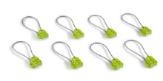
M14: Health Units
SCORING CONDITIONS:
  Health units are:
  Touching either the RePLAY logo or the gray area around the bench
  Looped over a pull-up bar post
SETUP:
  3 in home, 1 each on dance floor, pull-up east side post, on mark south center and east center
DETAILS
  When looped over pull-up bar post
    Maximum of 4
    Not touching equipment
  Keep loops mostly symmetrical and vertical

Slide 32
M15: Precision
SCORING CONDITIONS:
  Award score for number of tokens left on the field at the end of the match
SETUP:
  Place the 6 precision tokens in the white triangle in the south-east corner
DETAILS:
  Remove a token
    When the robot is interrupted while not completely in home
    When former cargo is stranded partly outside home

Slide 33
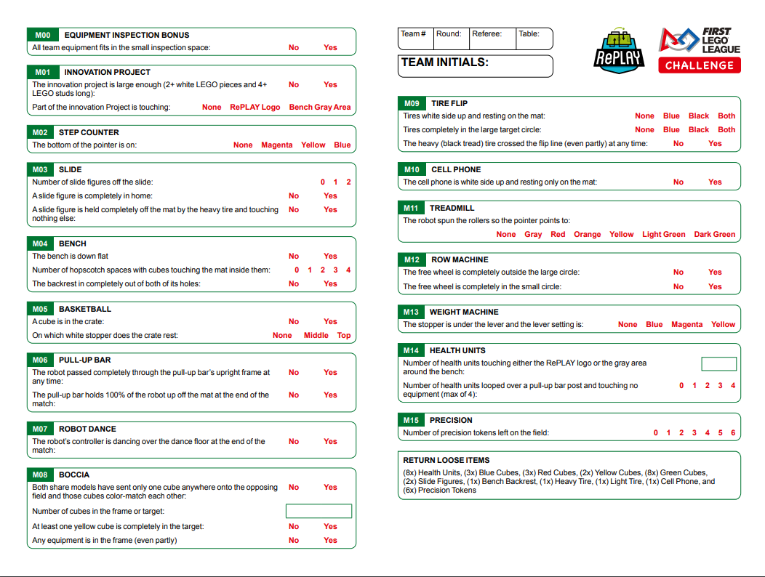
Scoresheet

Slide 34
Remote matches
Check with the Tournament Director or partner to understand if feedback is going to be given after practice matches.
Referee the video of the team's robot game in the same way you would referee any other match. But remember that you can use the Benefit of the Doubt rule if needed.
Notes:
Presenter(s):
Moderator(s):

Slide 35

RePLAY Robot Game Missions Video
Notes:
Presenter(s):
Moderator(s):

Slide 36

Questions?
Notes:
Presenter(s):
Moderator(s):

